Slide 1

Vachana Pitamaha Dr. P.G. Halakatti College of Engineering & Technology, Vijayapur-586103
Department of Computer Science and Engineering
Final Year Project Demo on
Maturity and Disease Detection of Strawberries
Guided by:
Prof. Sushma.S.Toravi Submitted by:
Charmi Oswal(2BL16CS019)
Dhanashri Kabra(2BL16CS022)
Priyanka Dhoot(2BL16CS068)

Slide 2
Contents
Introduction
Existing System
Literature Survey
Proposed System
Methodology
Applications
References

Slide 3
Introduction
The disease detection in fruits and vegetables play an important role in cultivation.
Fruit disease are the crucial factor and causes 20-30% reduction of the productivity in case of its infection.
Fruits are also unfit for human consumption when they mature beyond permissible limit which can be termed as rotten.
Various image processing methods and deep learning methods are applied to identify the maturity of the fruit using RGB values and also the infection in the fruit is detected.

Slide 4
Literature Survey
Year and Author | Title | Methodology | Advantage | Disadvantage | Result
2009, Liming Xu,Yanchao Zhao | Strawberry Maturity Neural Network Detecting System Based on Genetic Algorithm. | The H frequency is analysed and the neural network system is used to detect maturity which uses genetic algorithm. | Maturity of the fruit at different light intensities can be found. | Fruit is classified only into to three maturity categories. | 60 images for testing data were used, providing the accuracy of 91.7%.
2010, Xu Liming, Chen Liming, Wang Haifeng | Strawberry Maturity Distinguish Based on Relationship of Extracted Colour Feature Value and the Physiological and Biochemical Indices. | The frequency a* of a strawberry at certain light intensity is found to be correlated to various indices of strawberry and hence both maturity and indices value is calculated. | The physiological and biochemical features can be predicted along with the maturity of the fruit. | Fruit is classified only into to three maturity categories. | This system leads to the accuracy of 92% in detecting the maturity of the fruit and 80% in predicting the physiological values.
2013, Changqi Ouyang, Daoliang Li, Jianum Wang, Shuting Wang, Yu Han | The Research of the Strawberry Disease Identification Based on Image Processing and Pattern Recognition | Synthesis segmentation algorithm and OSTU .The methods of gray morphology and logical operation and mean shift segmentation for the image and SVM and BP neural network | The support vector machine has a higher recognition rate than the BP neural network so that support vector machine is used as the classsifier | The algorithm obtained effective segmentation result to the online images of the common kinds of dieased.

Slide 5
Literature Survey
Year and Author | Title | Methodology | Advantage | Disadvantage | Result
In 2016, Kranti D.Raut and Prof. Vibha Bora | Assessment of Fruit Maturity using Direct Color Mapping. | The preprocessing of the image is done using MATLAB and the RGB values are used to find the maturity of the strawberry. | Does not disturb the plant and is cost effective and easy. | Fruit is classified only into to three maturity categories. | It has the accuracy of 58%.
In 2016, Kranti D.Raut and Prof. Vibha Bora | Assessment of fruit maturity using digital image processing. | It make use of image processing and artificial neural network and MATLAB software for image analysis and ANN for modeling | Low cost and a versatile way to measure color of many foods more than traditional way. | This technique provides lesser accuracy despite of low cost. | It has the accuracy of 60% in strawberry fruit.
In 2017, Ayesha L. Tilwani and Prof. Devang G.Jani | Disease Detection in Leaves using Image Processing Techniques. | The GLCM, SVM, K-means algorithms are used for extraction, classification and segmentation respectively. | It is easy to make modifications and provides best accuracy with minimum dataset. | Too many algorithms used in the system makes it complex. | It provides the accuracy of 92%.

Slide 6
Literature Survey
Year and Author | Title | Methodology | Advantage | Disadvantage | Result
2018, Hyeon Park, Eun JeeSook and Se-Han Kim | Crop Disease Diagnosing using Image-based Deep Learning Mechanism. | CNN algorithm is used to classify the healthy and disease strawberry, also uses TensorFlow and Keras to built the neural network. | Better accuracy than previous methods. | Only the fruit is checked for the disease, not the other parts of crop. | Provides the accuracy of 92%.
2018, Oka Mahendra, Hilman F. Pardede, Rika Sustika, R . Budiarianto Suryo Kumso | Comparison of Features for Strawberry Grading Classification with Novel Dataset. | SVM algorithm is used to classify the fruit as good or disease. The color features of the strawberry are compared with the various models. | This method uses dynamic images not the static image. | The different amount of keypoints for each sample image makes it difficult while classifying using SVM. | This algorithm provides the best accuracy of 90.73% when SURF feature model is used.
2019, Dwi Esti Kusumandari, Muhammad Adzkia, Sanggam P. Gultom, Mardi Turnip, Arjon Turnip | Detection of Strawberry Plant Disease Based on Leaf Spot Using Color Segmentation. | The image improvement followed by color segmentation to HSV color space then the regional segmentation to determine the deformed area . | Detects disease from both leaf and fruit. | There are applications with better accuracy. | This method provides the accuracy of 85%.

Slide 7
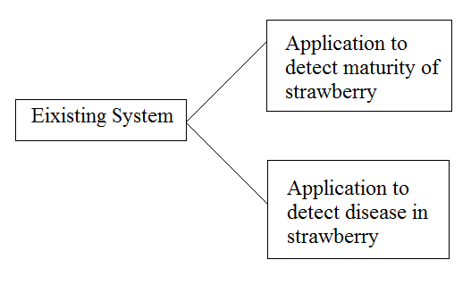
Existing System
Makes use of image processing algorithms. Whose efficiency is less as compared to Machine Learning algorithms.

Slide 8
Proposed System
The main objective of this project is to check the maturity of strawberry fruit and to detect disease in strawberries both under single application.
Various Machine Learning algorithms are used in the proposed system.

Slide 9
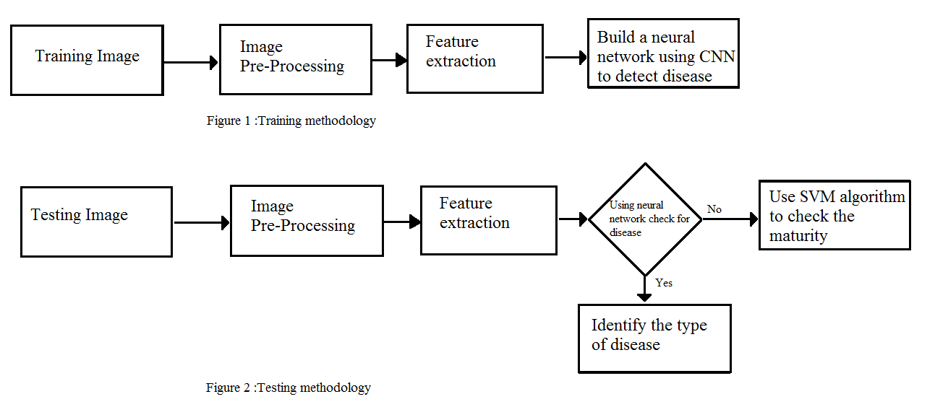
Methodology

Slide 10
References
[1] Liming Xu, Yanchao Zhao, “Strawberry Maturity Neural Network Detecting System Based on Genetic Algorithm”. International Federation for Information Processing, Volume 294(2009).
[2] Xu Liming, Chen Liming, Wang Haifeng, “Strawberry Maturity Distinguish Based on Relationship of Extracted Color Feature Value and the Physiologic and Biochemical Indices”. World Automation Congress(2010).
[3] Changqi Ouyang, Daoliang Li, Jianlum Wang, Shuting Wang and Yu Han, “The Research of the Strawberry Disease Identification Based on Image Processing and Pattern Recognition”. CCTA 2012, Part I, IFIP AICT 392(2013).
[4] Kranti D.Raut and Prof. Vibha Bora, “Assessment of Fruit Maturity using Direct Color Mapping”. International Research Journal of Engineering and Technology (IRJET) Volume: 03 Issue: 03(2016).
[5] Kranti D.Raut and Prof. Vibha Bora, “Assessment of fruit maturity using digital image processing”. IJSTE - International Journal of Science Technology & Engineering Volume 3 Issue 01(2016).
[6] Ayesha L. Tilwani and Prof. Devang G.Jani, “Disease Detection in Leaves using Image Processing Techniques”. International Research Journal of Engineering and Technology (IRJET) Volume: 04 Issue: 04(2017).
[7] Hyeon Park, Eun JeeSook and Se-Han Kim “Crop Disease Diagnosing using Image-based Deep Learning Mechanism”. Second International Conference on Computing and Network Communications(2018).
[8] Oka Mahendra, Hilman F. Pardede, Rika Sustika, R . Budiarianto Suryo Kumso, “Comparison of Features for Strawberry Grading Classification with Novel Dataset”. International Conference on Computer, Control, Informatics and its Applications(2018).
[9] Dwi Esti Kusumandari, Muhammad Adzkia, Sanggam P. Gultom, Mardi Turnip, Arjon Turnip, “Detection of Strawberry Plant Disease Based on Leaf Spot Using Color Segmentation”. IOP Conf. Series: Journal of Physics: Conf. Series 1230(2019).

